Slide 1
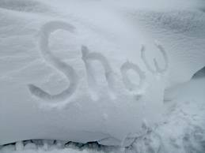
So its a snow day.....
Your task:
1 – Produce an explanation of why it snows
or
2 – Create a photographic montage of the effect that snow has on the landscape where you live

